Slide 1
Ksc6103 data STRUCTURE & algorithm analysis
Algorithm Analysis

Slide 2



Learning Outcome
Understand the concepts of algorithm complexity and asymptotic analysis.
Identify the complexity of algorithm using Big-O notation.
Differentiate between Big-O, Big-Omega and Big-Theta.

Slide 3
Overview
Introduction
Type of Analyses
Best case
Worst case
Average case
Various function used form analyzing rate of growth
Asymptotic analysis:
Big-Oh notation
Big-Omega notation
Big-Theta notation
Comparison between various kinds of complexities
Examples of how efficient algorithms can be modified to reduce computational complexity
Summary

Slide 4
INTRODUCTION

Slide 5
What is an Algorithm?
An algorithm is a step-by-step procedure with unambiguous instructions to solve a given problem.

Slide 6
What is a data structure?
A data structure is a systematic way of organizing and accessing data.

Slide 7
Why the analysis of Algorithm required?
There are multiple algorithms for doing things. Algorithm analysis helps us in selecting the most efficient algorithm in terms of time and space consumed.

Slide 8
What is the Goal of Algorithm Analysis?
To compare algorithms (or solutions) mainly in terms of running time, also other factors (memory requirement, developer effort etc.).

Slide 9
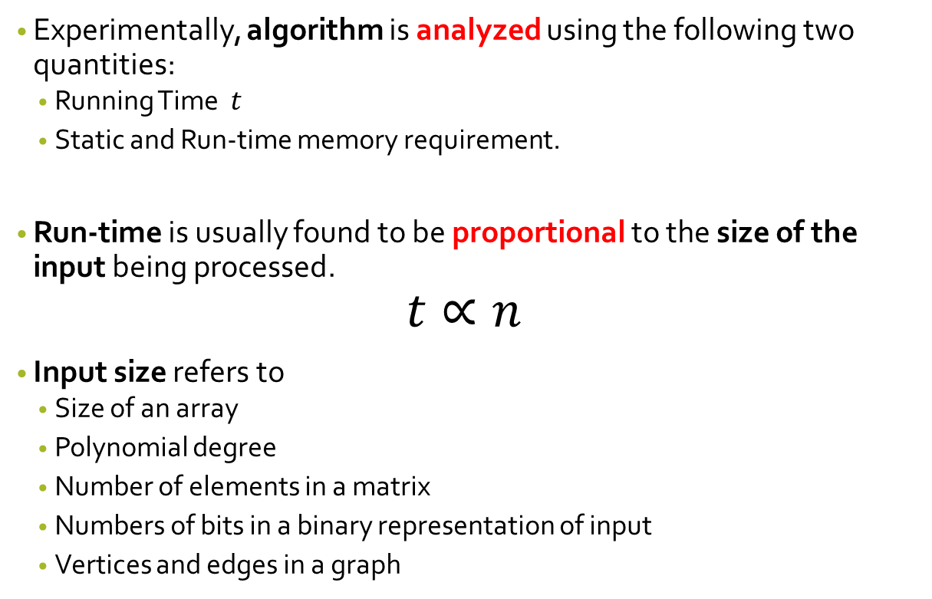
Experiment Analysis of Algorithms
Experimentally, algorithm is analyzed using the following two quantities:
Running Time $t$
Static and Run-time memory requirement.
Run-time is usually found to be proportional to the size of the input being processed.
$$t∝n$$
Input size refers to
Size of an array
Polynomial degree
Number of elements in a matrix
Numbers of bits in a binary representation of input
Vertices and edges in a graph

Slide 10
Challenges of Experimental Analysis
Experimental running time depends on the hardware and software platform used for implementation.
Experiments can be done only on a limited set of test inputs.
An algorithm needs to be fully implemented for execution and study its running time experimental.

Slide 11
Objectives of Algorithm Analysis
Our goal is to develop an approach of analyzing the efficiency of algorithms that:
Allows us to evaluate relative efficiency of algorithms in a way that is independent of the hardware and software environment.
Is performed by studying high-level description of the algorithm without need for implementation.
Takes into account all possible inputs.

Slide 12
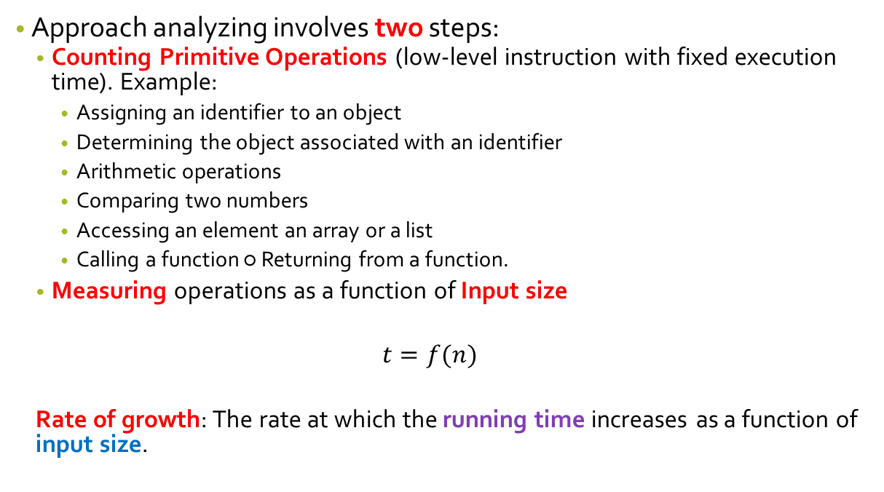
Objectives of Algorithm Analysis
Approach analyzing involves two steps:
Counting Primitive Operations (low-level instruction with fixed execution time). Example:
Assigning an identifier to an object
Determining the object associated with an identifier
Arithmetic operations
Comparing two numbers
Accessing an element an array or a list
Calling a function ○ Returning from a function.
Measuring operations as a function of Input size
$$t=f(n)$$
Rate of growth: The rate at which the running time increases as a function of input size.

Slide 13
TYPES OF ANALYSIS

Slide 14
Types of Analysis
Worst Case
Defines the input for which the algorithm takes maximum time complete
Best Case
Defines the input for which the algorithm takes minimum time to complete
Average Case
Provides an average prediction about the running-time of the algorithm.
Needs to have understanding of probability distribution of input data.

Slide 15
FUNCTION FOR ANALYSING RATE OF GROWTH

Slide 16
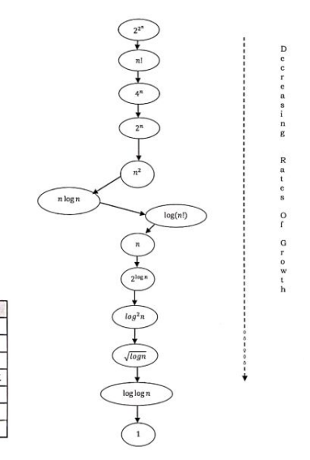

Introduction
Approximation:
$$Total Cost=cost of car+cost of bicycle$$
$$n^{4}+ {2n}^{2}+100n+500 ≈ n^{4}$$

Slide 17
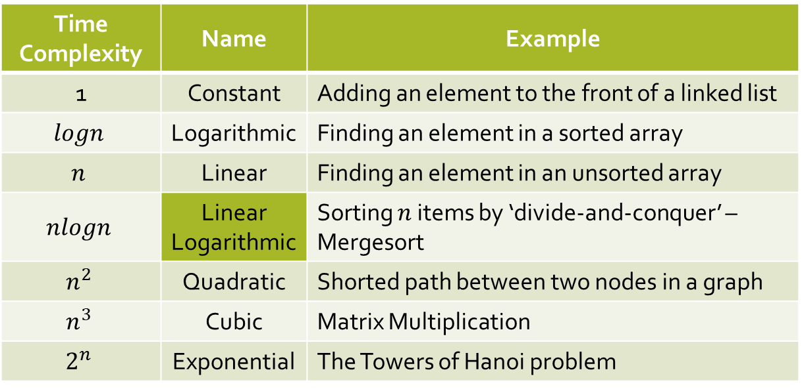
Introduction
Time Complexity | Name | Example
1 | Constant | Adding an element to the front of a linked list
$$logn$$ | Logarithmic | Finding an element in a sorted array
$$n$$ | Linear | Finding an element in an unsorted array
$$nlogn$$ | Linear Logarithmic | Sorting $n$ items by ‘divide-and-conquer’ – Mergesort
$$n^{2}$$ | Quadratic | Shorted path between two nodes in a graph
$$n^{3}$$ | Cubic | Matrix Multiplication
$$2^{n}$$ | Exponential | The Towers of Hanoi problem

Slide 18
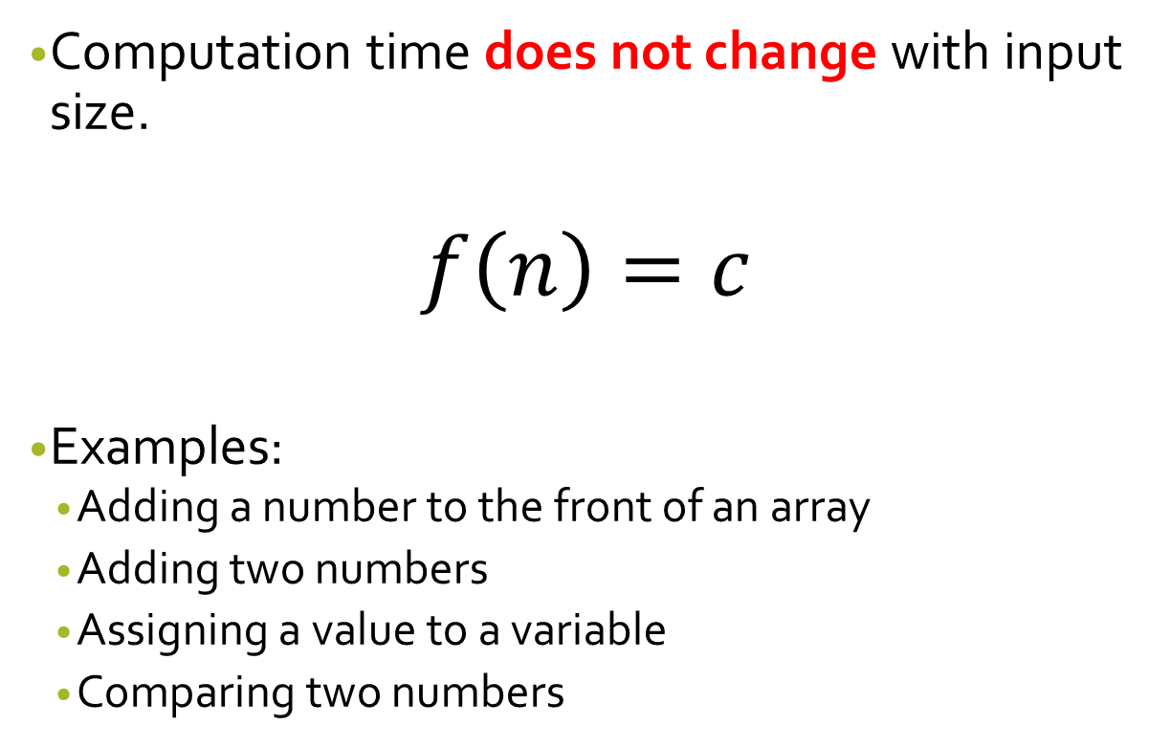
The Constant Function
Computation time does not change with input size.
$$f\left(n\right)=c$$
Examples:
Adding a number to the front of an array
Adding two numbers
Assigning a value to a variable
Comparing two numbers

Slide 19
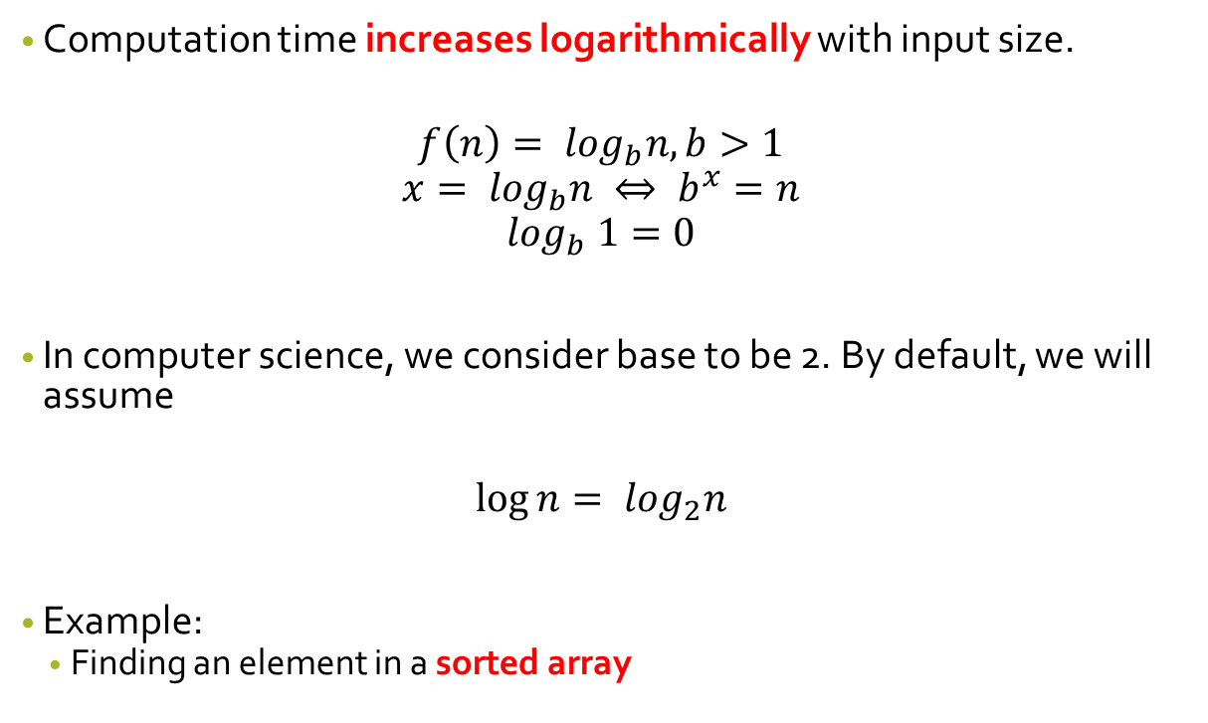
The Logarithmic Function
Computation time increases logarithmically with input size.
$$f\left(n\right)= \log_{b}n, b>1$$
$$x= \log_{b}n ⇔ b^{x}=n$$
$$\log_{b} 1=0$$
In computer science, we consider base to be 2. By default, we will assume
$$\log{n= \log_{2}n}$$
Example:
Finding an element in a sorted array

Slide 20
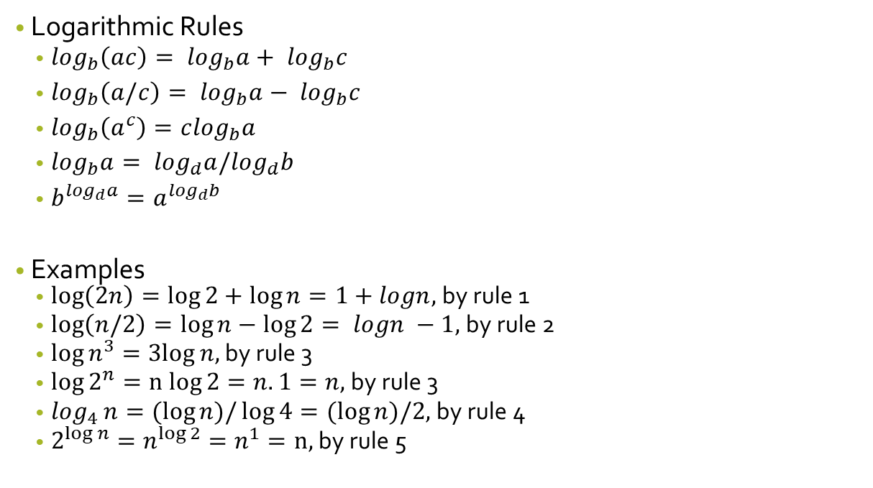
The Logarithmic Function
Logarithmic Rules
$\log_{b}\left(ac\right)= \log_{b}a+ \log_{b}c$
$\log_{b}\left(a/c\right)= \log_{b}a− \log_{b}c$
$\log_{b}\left(a^{c}\right)=c\log_{b}a$
$\log_{b}a= \log_{d}a/\log_{d}b$
$b^{\log_{d}a}=a^{\log_{d}b}$
Examples
$\log\left(2n\right)=\log{2+\log{n}=1+logn, }$by rule 1
$\log\left(n/2\right)=\log{n−\log{2}= logn −1, }$by rule 2
$\log{n^{3}}=3log{n, }$by rule 3
$\log{2^{n}}=n log{2=n.1=n, }$by rule 3
$\log_{4}{n}=(log{n)/\log{4}=(\log{n})/2, }$by rule 4
$2^{log n}=n^{log 2}=n^{1}=n{, }$by rule 5

Slide 21

The Linear Function
The computation time is increases linearly with input size.
$$f\left(n\right)=n$$
Example:
Finding an element in an unsorted array

Slide 22
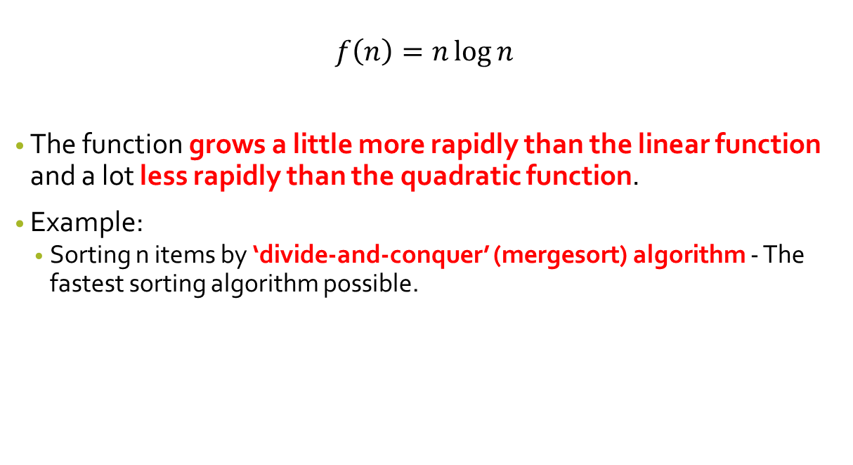
The N-Log-N function
$$f\left(n\right)=n\log{n}$$
The function grows a little more rapidly than the linear function and a lot less rapidly than the quadratic function.
Example:
Sorting n items by ‘divide-and-conquer’ (mergesort) algorithm - The fastest sorting algorithm possible.

Slide 23
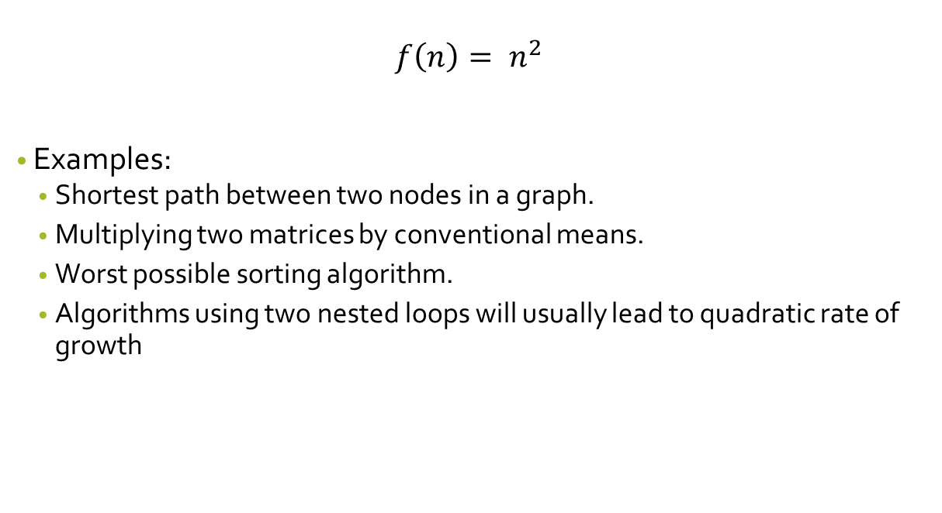
The quadratic function
$$f\left(n\right)= n^{2}$$
Examples:
Shortest path between two nodes in a graph.
Multiplying two matrices by conventional means.
Worst possible sorting algorithm.
Algorithms using two nested loops will usually lead to quadratic rate of growth

Slide 24
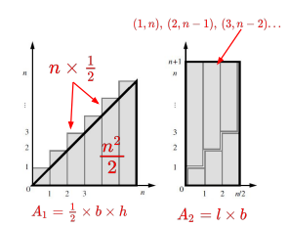

The quadratic function
Nested Loops and Quadratic Function
$$1+2+3+ …+\left(n−1\right)+n= \frac{n\left(n+1\right)}{2};n≥1$$
$$[\left\{1+n\right\}+\left\{2+(n−1)\right\}+\left\{3+(n−2)\right\}+…] = \frac{n\left(n+1\right)}{2}$$

Slide 25
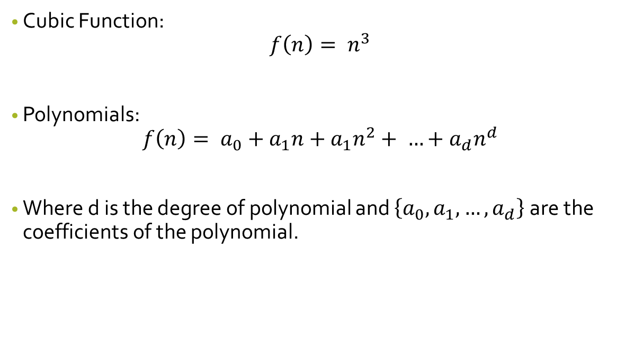
Cubic Function & Other Polynomials
Cubic Function:
$$f\left(n\right)= n^{3}$$
Polynomials:
$$f\left(n\right)= a_{0}+a_{1}n+a_{1}n^{2}+ …+a_{d}n^{d}$$
Where d is the degree of polynomial and $\left\{a_{0},a_{1},…,a_{d}\right\}$are the coefficients of the polynomial.

Slide 26
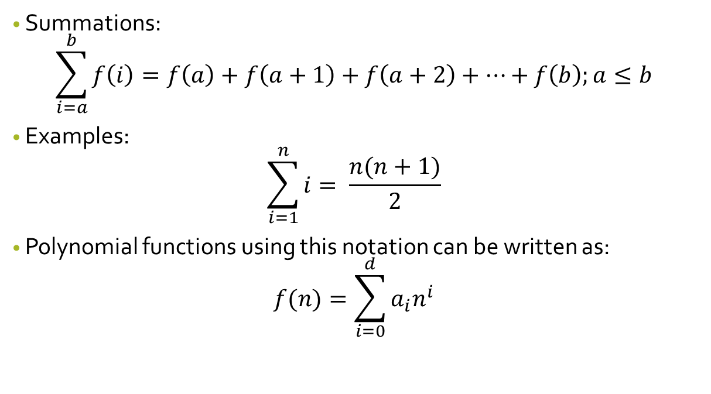
Cubic Function & Other Polynomials
Summations:
$$\sum_{i=a}^{b}{f\left(i\right)=f\left(a\right)+f\left(a+1\right)+f\left(a+2\right)+…+f\left(b\right);a≤b}$$
Examples:
$$\sum_{i=1}^{n}{i= \frac{n(n+1)}{2}}$$
Polynomial functions using this notation can be written as:
$$f(n)=\sum_{i=0}^{d}{a_{i}n^{i}}$$

Slide 27


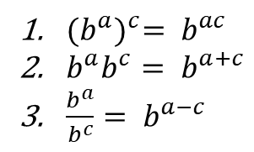
The Exponential Function
$$f\left(n\right)= b^{n}$$
Where b is the base and n is the exponent.
Exponent Rules:
Examples:
256
243
16
${(b^{a})}^{c}= b^{ac}$
$b^{a}b^{c}= b^{a+c}$
$\frac{b^{a}}{b^{c}}= b^{a−c}$

Slide 28

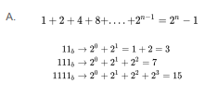
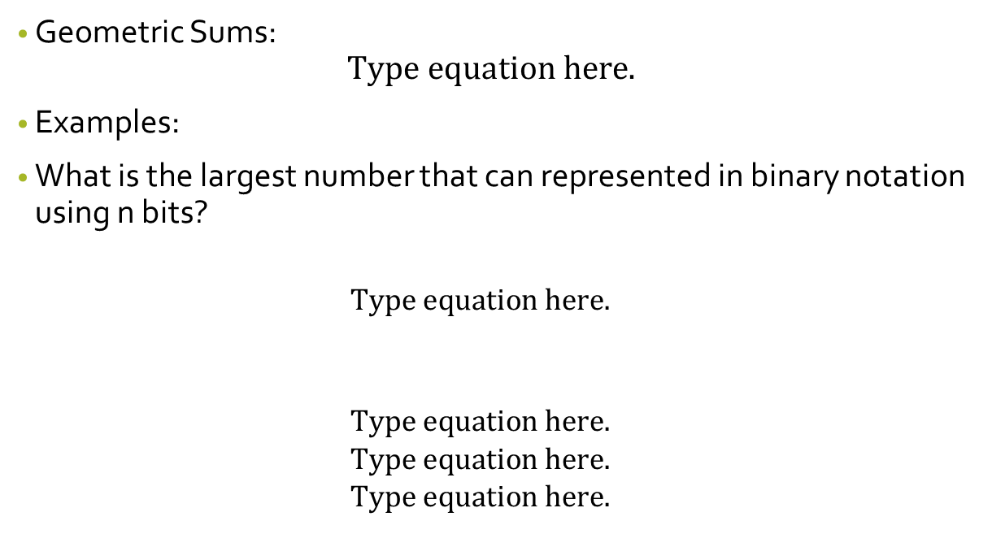
The Exponential Function
Geometric Sums:
Examples:
What is the largest number that can represented in binary notation using n bits?

Slide 29
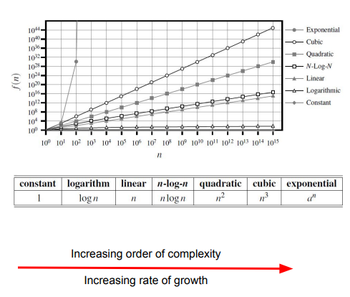
Comparing Growth Rates
Ceiling and Floor Function:
[x]=The largest integer less than or equal to x..
[x]=The smallest integer greater than or equal to x.

Slide 30
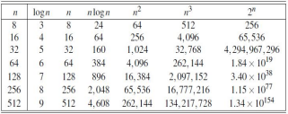
Comparative Analysis of various growth rates
It shows the importance of good algorithm design.
The handicap of an asymptotically slower algorithm can not be overcome by using a dramatic speedup in hardware.
An asymptotically slow algorithm is beaten in the long run by an asymptotically faster algorithm, even if the constant factor for the faster algorithm is worse.

Slide 31
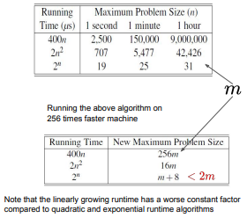
Comparative Analysis of various growth rates
Maximum size of a problem that can be solved in 1 second, 1 minute and 1 hour, for various running times measured in microseconds.

Slide 32
Asymptotic analysis

Slide 33

Introduction
It is an approximate analysis an algorithm complexity as n tends to infinity.
We focus on the growth rate of the running time as a function of the input size n.
The “Big-Oh” Notation:
The big-Oh notation allows us to say that a function f(n) is “less than or equal to” another function g(n) up to a constant factor and in the asymptotic sense as n grows toward infinity.
“Big-Oh” notations provides the tighter upper bound of a given function.

Slide 34
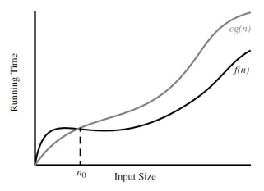
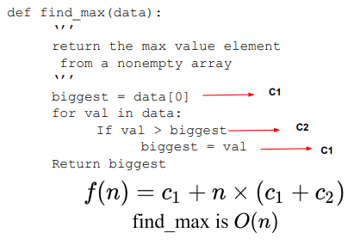
Introduction

Slide 35
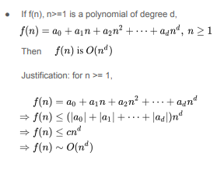
Big-Oh notation

Slide 36
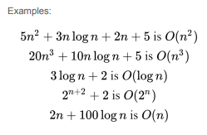
Big-Oh notation

Slide 37


Some words of Caution
Constant factors in Big-Oh notation should not be too large
When using the big-Oh notation, we should at least be somewhat mindful of the constant factors and lower-order terms we are “hiding”.
Similarly be careful of constants in exponentials:

Slide 38
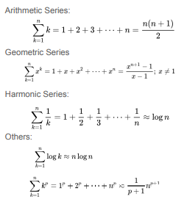
Commonly used summations

Slide 39
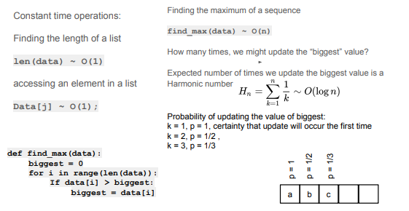
Examples of Asymptotic Analysis of Algorithm

Slide 40
Big-Oh notation
Example
Prove that : 3n+2 = O(n)
Answer
https://youtu.be/M0_9EpsxMjY
Other reference for Big Oh
https://youtu.be/L8HF-ntS5q4

Slide 41
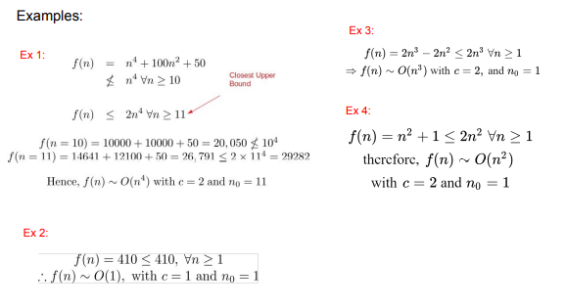
Example of Big-Oh (Calculation)

Slide 42
Lab Material
https://github.com/masyitah-abu/Data-Structure-and-Algorithm-in-Python

